Slide 1
BUG TRACKER
Team Broski

Slide 2
TEAM
Shivam Shekhar (RA1911030010026)
Ratanshi Puri (RA1911030010025)
Paras Rawat (RA1911030010023)
Project Link
https://bugtracker-sepm.herokuapp.com/

Slide 3
The trouble with programmers is that you can never tell what a programmer is doing until it’s too late.

Slide 4
INDEX
Introduction
Tech Stack
Stakeholder Analysis
Project Methodology
Scopes and Requirements
UML Diagrams
Product Images

Slide 5
IDEA

Slide 6
Introduction
A bug tracker is an open-source web platform which enables team members working on a project to collaborate and report and keep track of the bugs which they come across during their work. Bug Tracker helps us keep track of the progress of the project and provides a centralized view of the development progress. In a corporate environment, a bug-tracking system may be used to generate reports on the productivity of programmers at fixing bugs.
A bug tracking system or defect tracking system is a software application that keeps track of reported software bugs in software development projects.A major component of a bug tracking system is a database that records facts about known bugs. Facts may include the time a bug was reported, its severity, the erroneous program behavior, and details on how to reproduce the bug; as well as the identity of the person who reported it and any programmers who may be working on fixing it.

Slide 7
Steps Involved
● Bug detection: Bugs are detected by the development team during the product testing phase. They can also be detected and reported by end-users.
● Bug reporting: The developer identifies the bug and logs the time it was detected in the bug report.
● Bug fixing: Developers try different approaches to fix the bug.
● Software retesting: The software is tested repeatedly to ensure it works properly.
● Data capturing: All the data related to the bug is recorded in the bug report to avoid the same occurrence in the future.
Our project is based on the Data capturing step of the bug tracker , with its main aim to maintain a database for all bugs history in the open source software.

Slide 8
TECH STACK
Front-end
EJS
CSS
BootStrap
JS
Back-end
Node.js
Express.js
Firebase
Database
MongoDB
Deployment
Heroku
Hosting
GitHub
Version Control
Git

Slide 9
STAKEHOLDER ANALYSIS

Slide 10


WHY WE REQUIRE STAKEHOLDERS?
We identified a range of stakeholders prior to the problem-focused stages of project development. Early identification of stakeholders around a natural resource is critical for the management of that resources. A stakeholder is any actor that can affect, or can be affected by, a decision or action.

Slide 11



STAKEHOLDERS
Ratanshi Puri
Project Manager
Paras Rawat
Resource Allocator
Shivam Shekhar
Developer

Slide 12
PROJECT METHODOLOGY

Slide 13

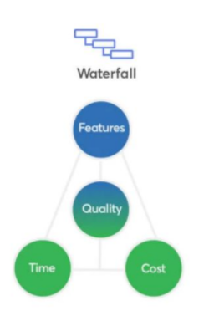
Waterfall Methodology
Waterfall Model methodology is also known as Linear Sequential Life Cycle Model. Waterfall
Model followed in the sequential order, and so the project development team only moves to the
next phase of development or testing if the previous step completed successfully.

Slide 14
SCOPES AND REQUIREMENTS

Slide 15
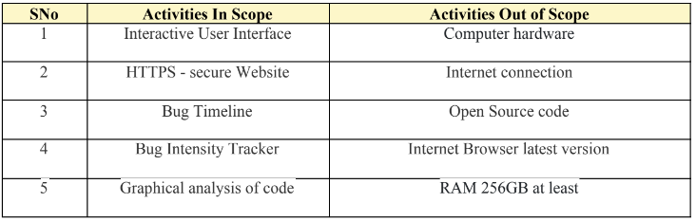
PROJECT SCOPE

Slide 16
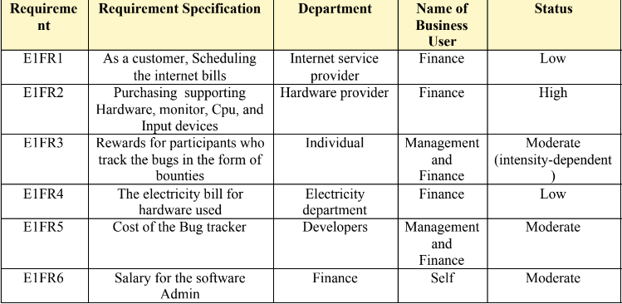
FUNCTIONAL REQUIREMENTS

Slide 17
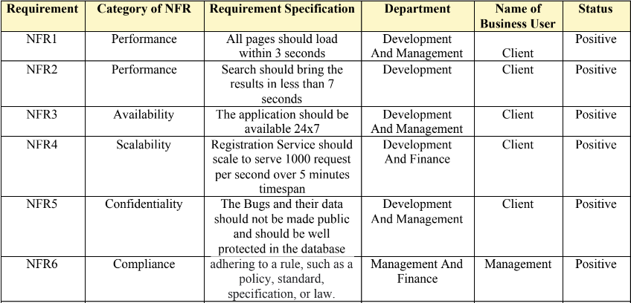
NON-FUNCTIONAL REQUIREMENTS

Slide 18
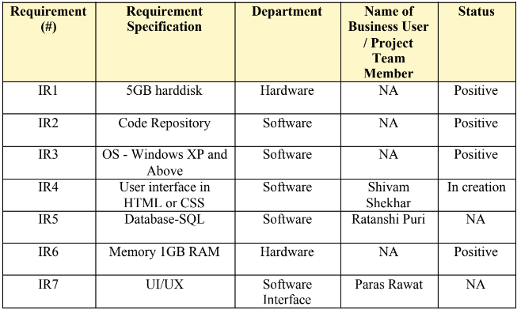
INFRASTRUCTURE REQUIREMENTS

Slide 19
SYSTEM DESIGN

Slide 20
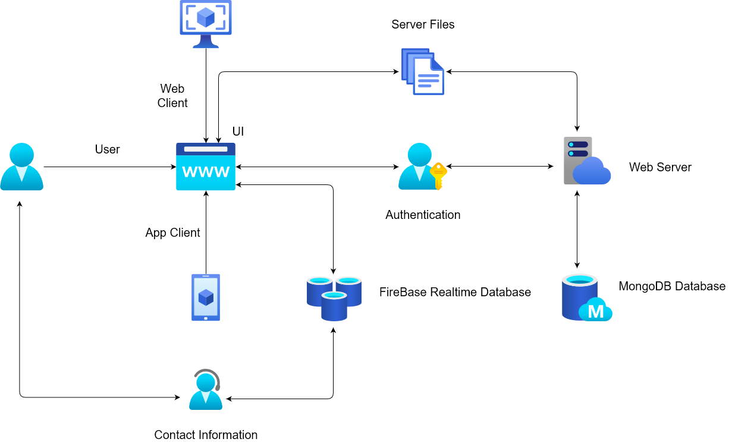
ARCHITECTURE DIAGRAM

Slide 21
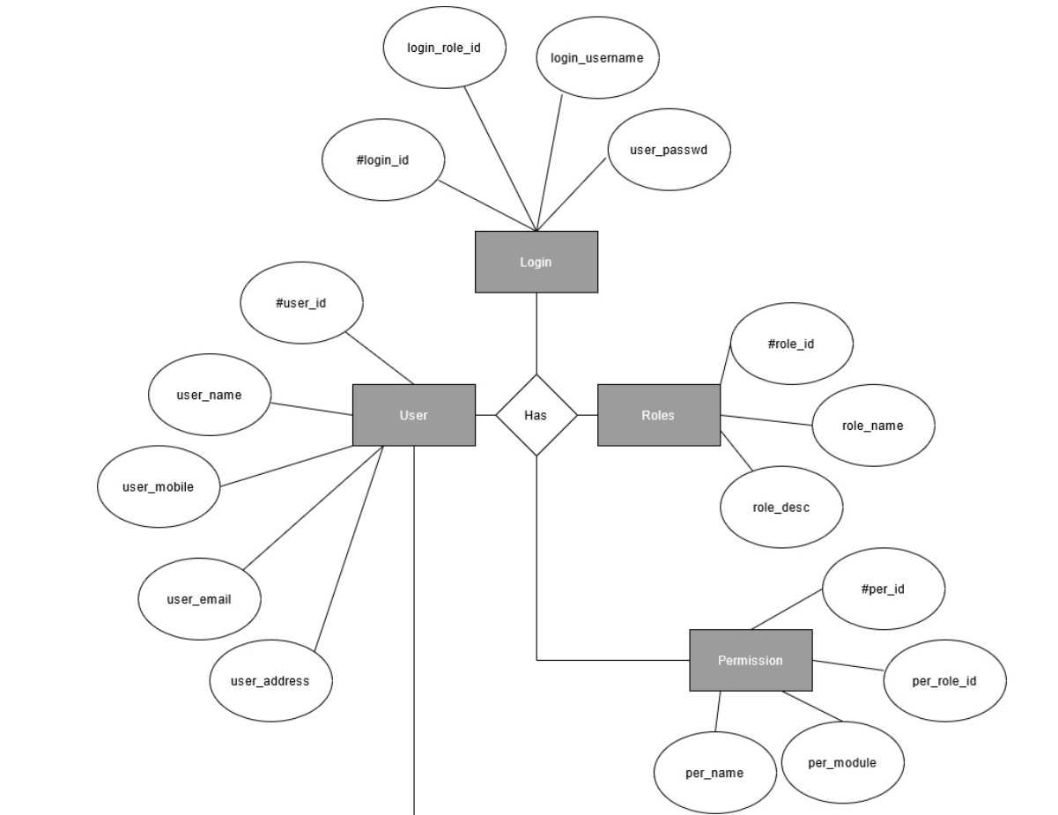
ER DIAGRAM

Slide 22
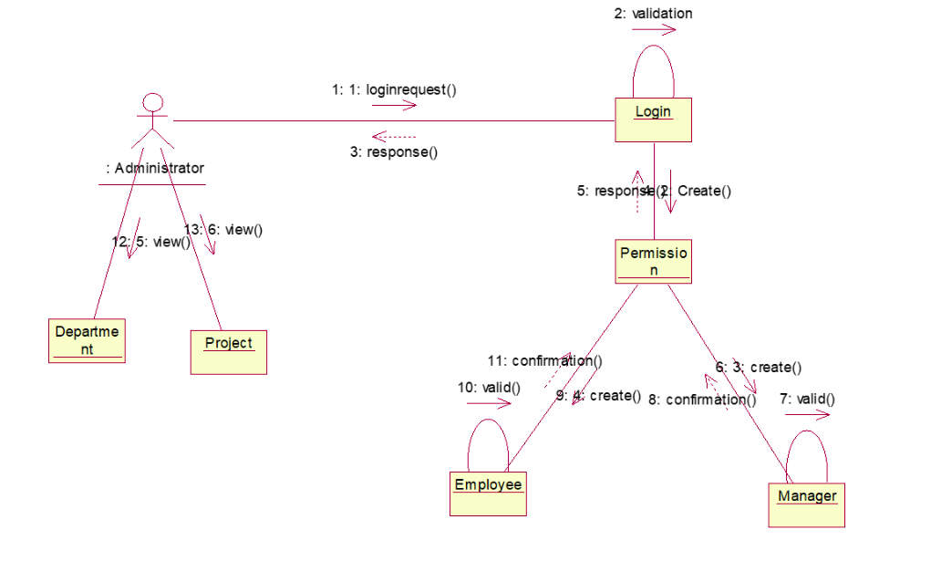
COLLABORATION DIAGRAM

Slide 23
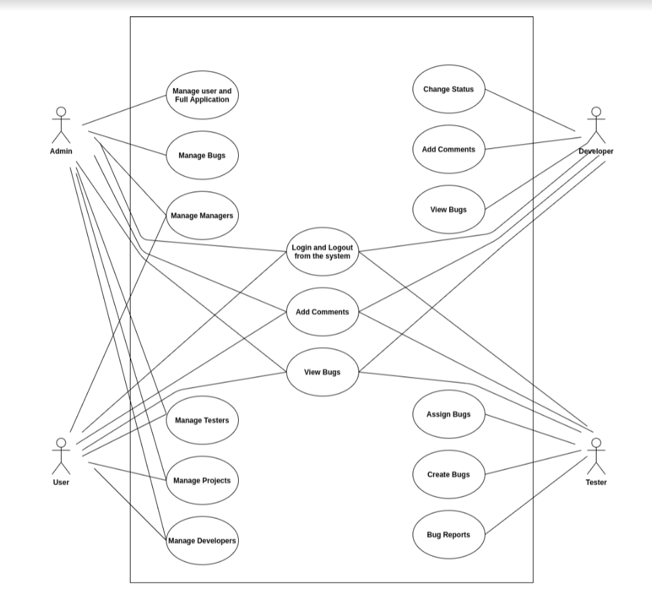
USE CASE DIAGRAM

Slide 24
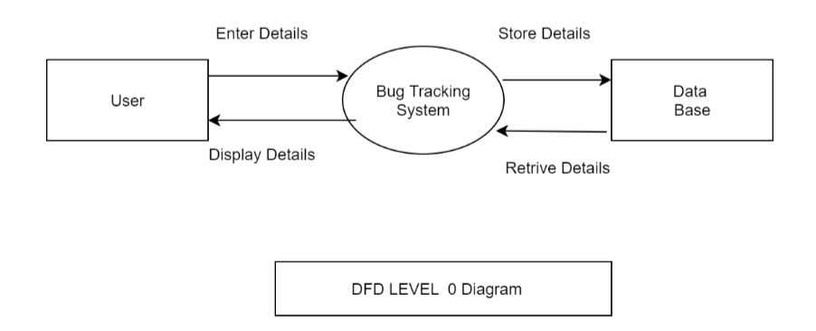
DFD DIAGRAM

Slide 25
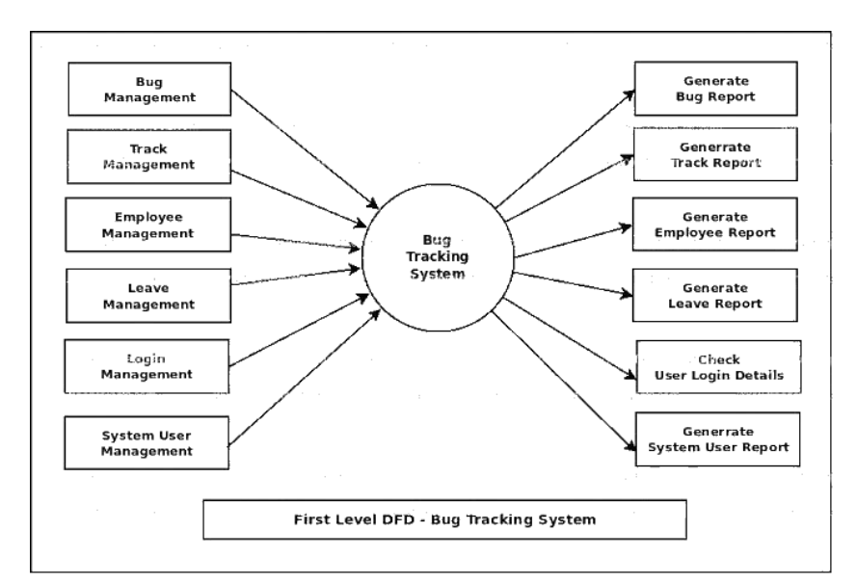
DFD DIAGRAM

Slide 26
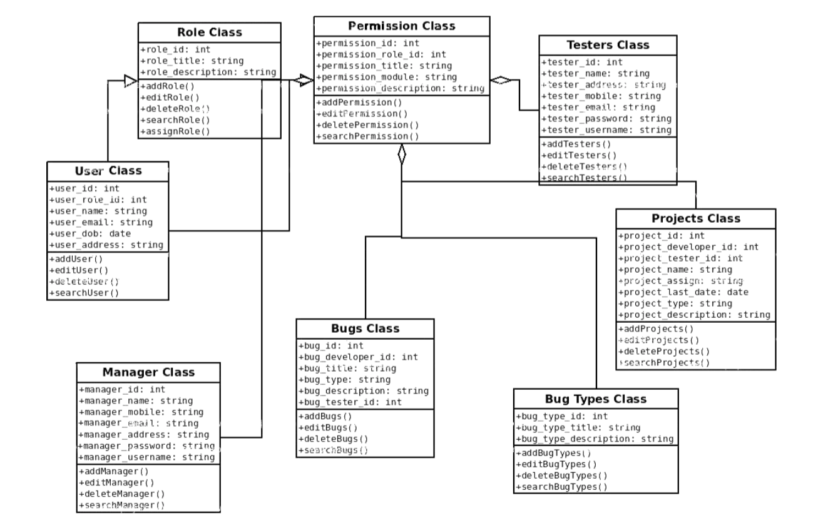
CLASS DIAGRAM

Slide 27
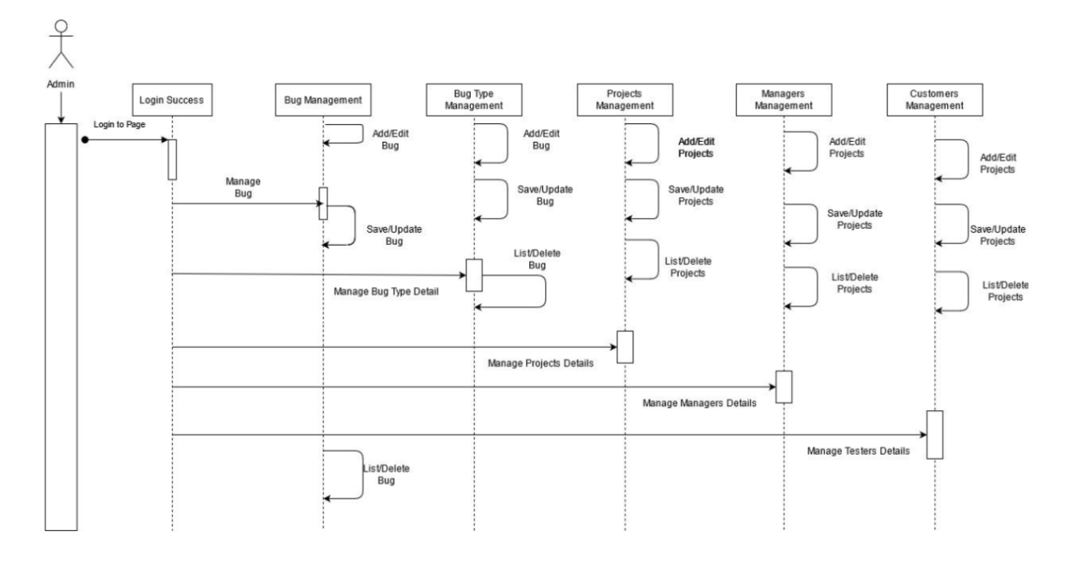
SEQUENCE DIAGRAM

Slide 28
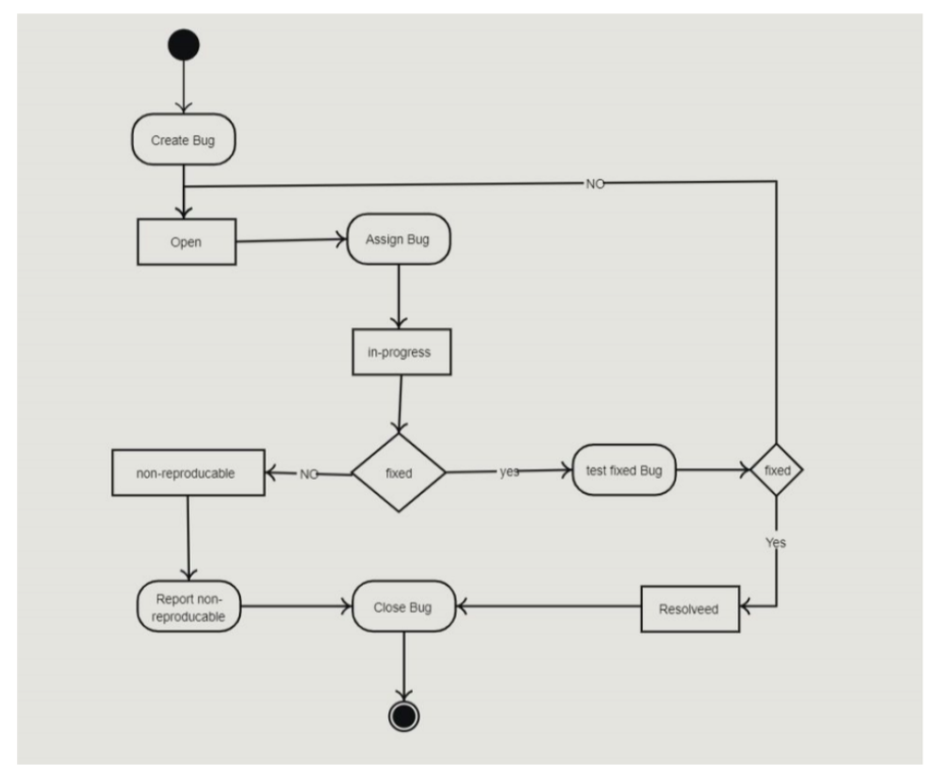
STATE DIAGRAM

Slide 29
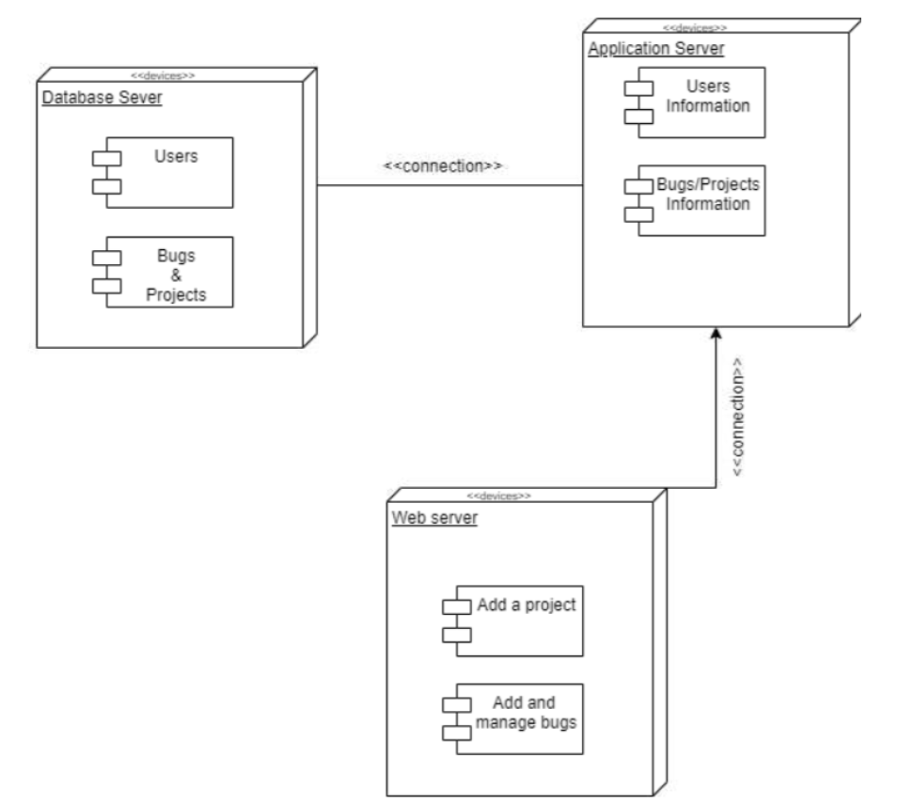
DEPLOYMENT DIAGRAM

Slide 30
PRODUCT

Slide 31
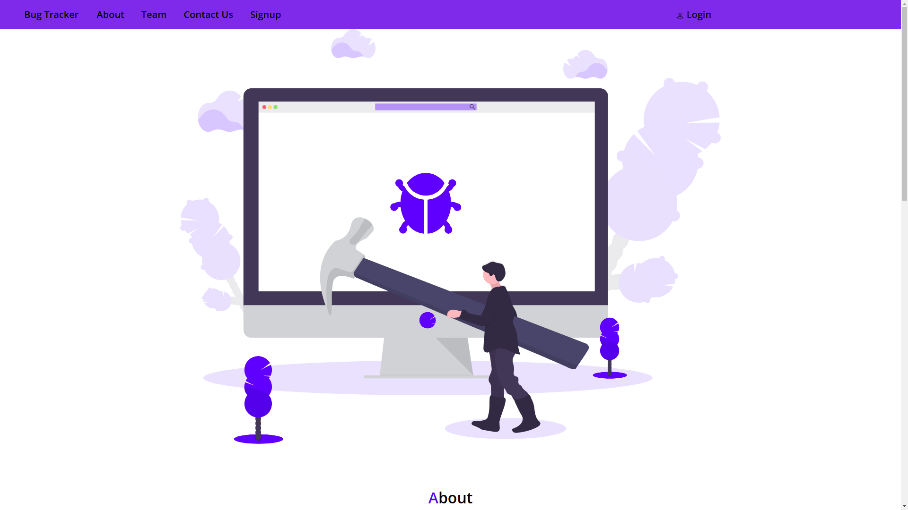
LANDING PAGE

Slide 32
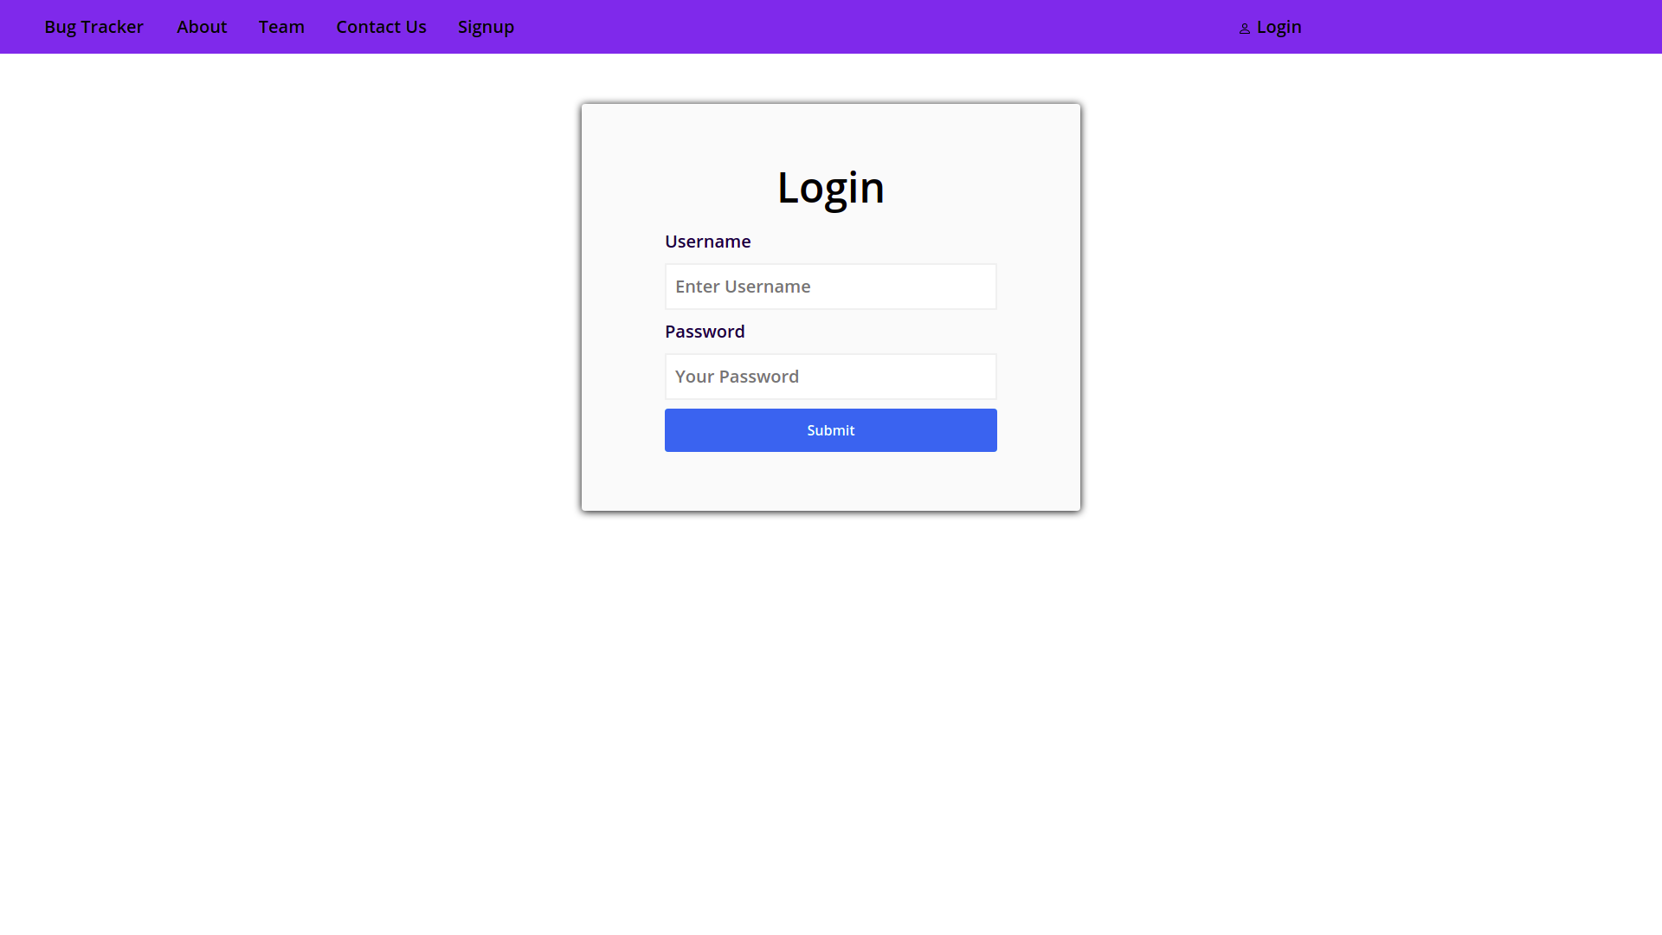
LOGIN PAGE

Slide 33
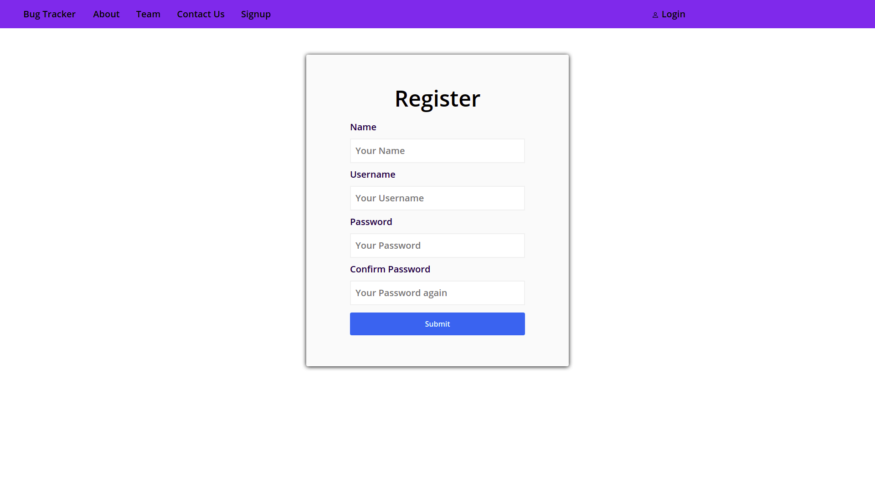
SIGNUP PAGE

Slide 34
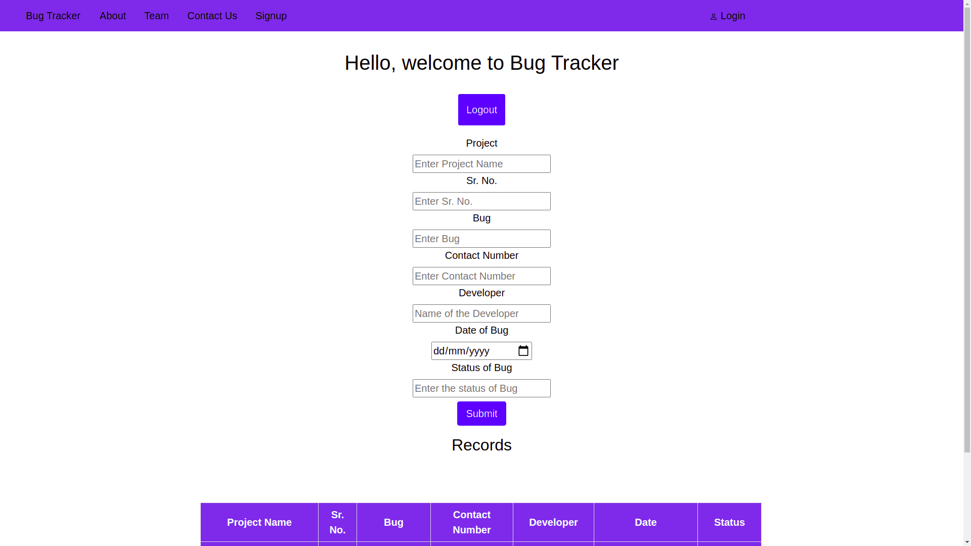
MAIN PAGE

Slide 35


THANKS!

